Slide 1
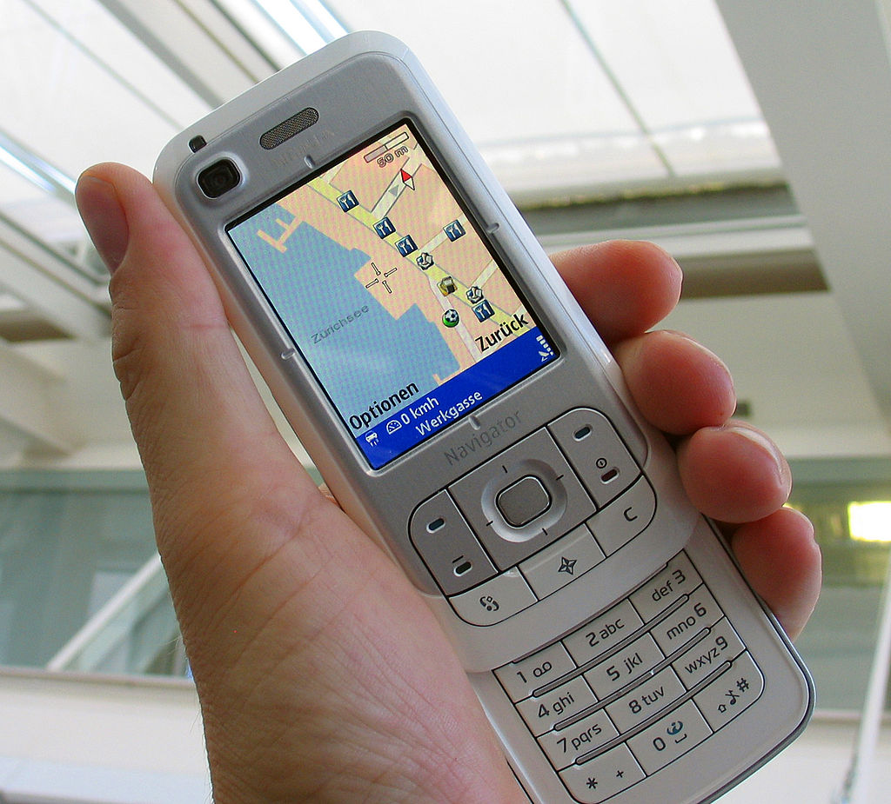
GPS (Global Positioning System)
Author: Jared Wasinger
Engineering Profession: Computer Science

